Slide 1
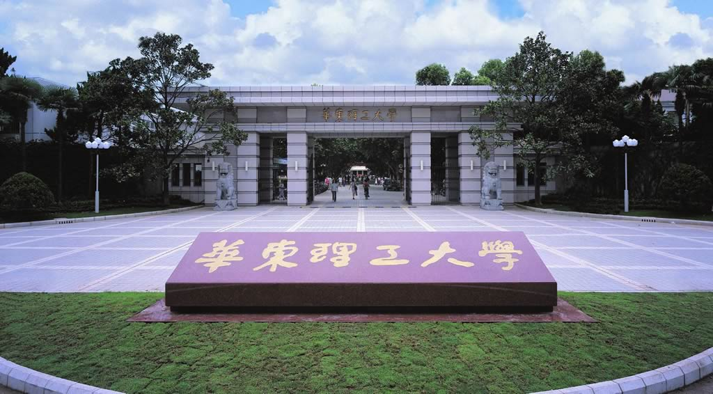
Chapter 7 Techniques for study protein-protein interaction
-- Interaction proteomics
Li-Qiang Fan
East China University of Science and Technolog

Slide 2
Outline
Why study protein-protein interactions？
How to study protein-protein interactions
Experimental methods
Computational prediction methods
Cases and application of protein-protein interactions study

Slide 3
Outline
Why study protein-protein interactions？
How study protein-protein interactions
Experimental methods
Computational prediction methods
Cases and application of protein-protein interactions study

Slide 4
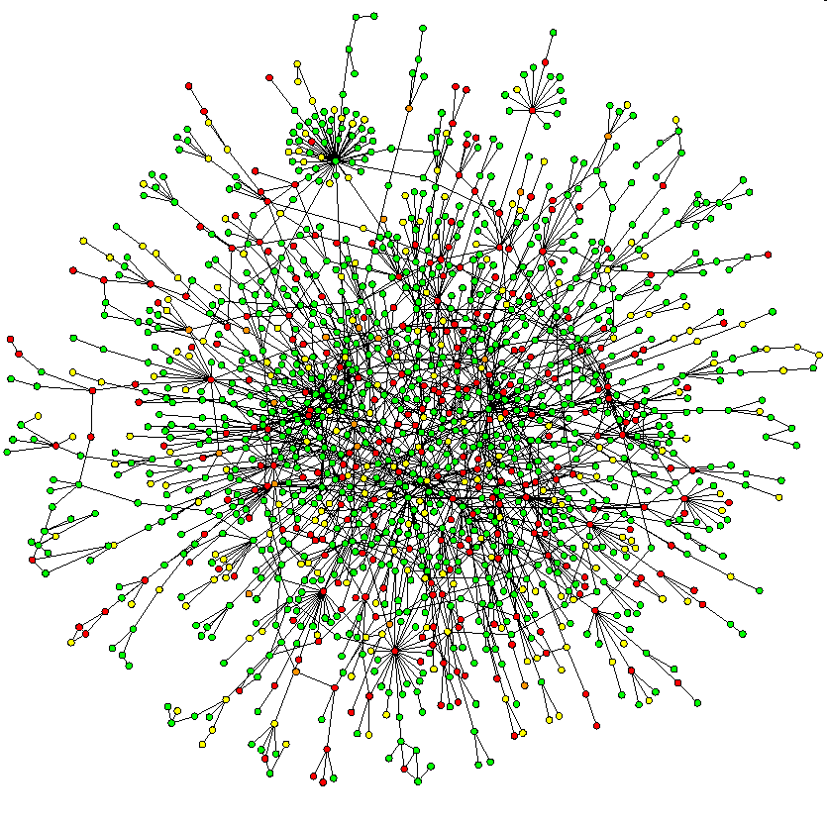
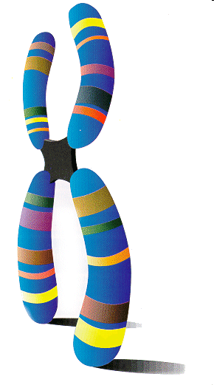
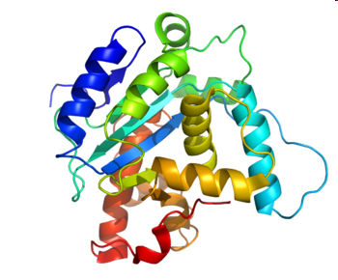
Why study protein-protein interactions (PPI)?
Gene is the basic unit of heredity. Genomes are available.
Proteins, the working molecules of a cell, carry out many biological activities
Some Proteins works alone；Some proteins function by interacting with other molecules like proteins.
genome
Proteome
interactome
Notes:
Proteins control all biological systems in a cell, and while many proteins perform their functions independently, the vast majority of proteins interact with others for proper biological activity.

Slide 5
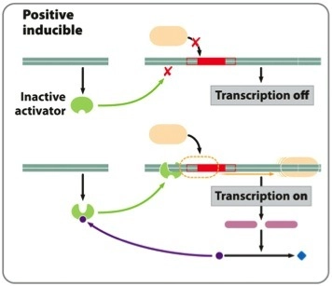
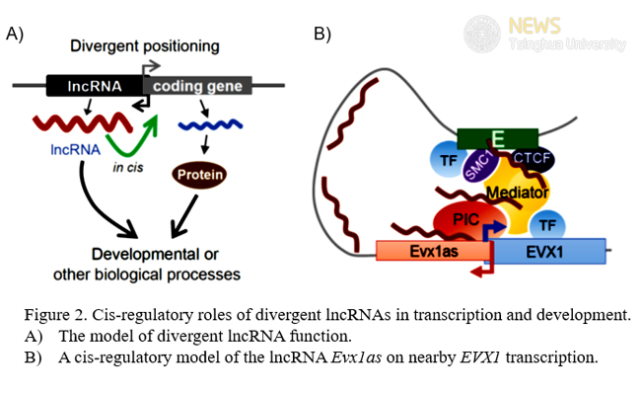
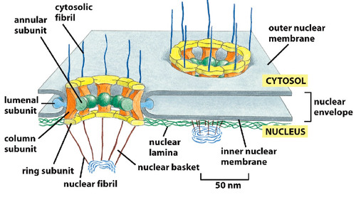
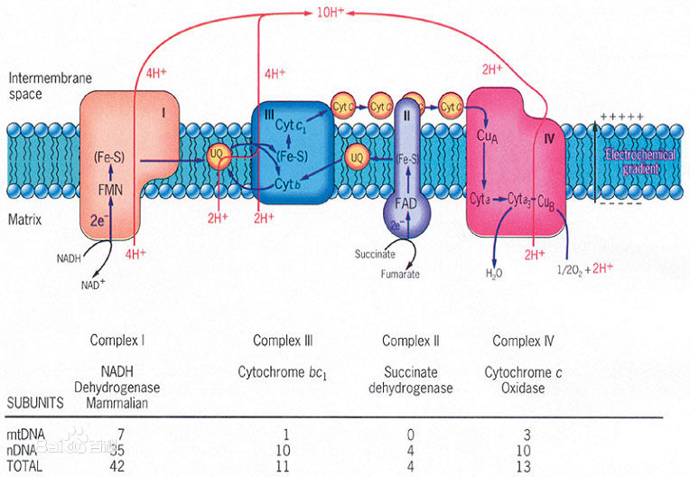
nuclear pore complex
Electron respiratory chain

Slide 6
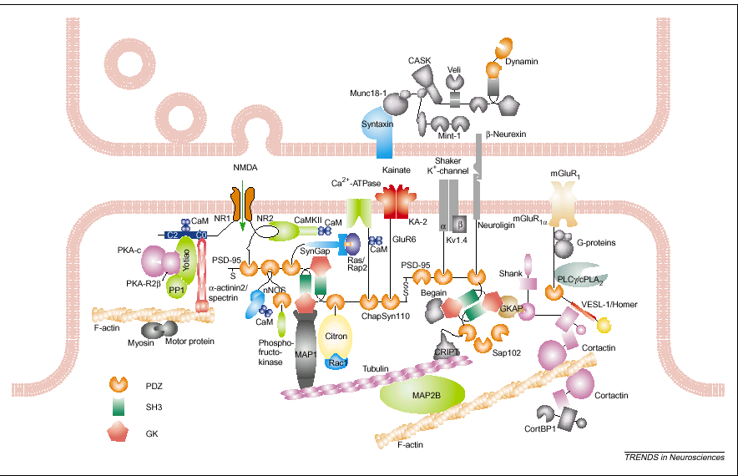
Synaptic protein complexes identified

Slide 7
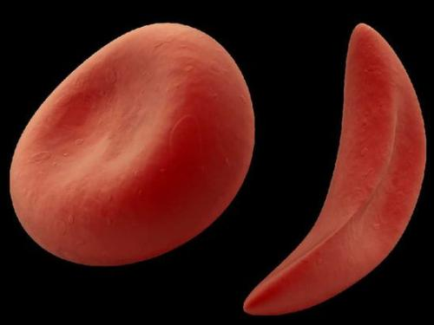
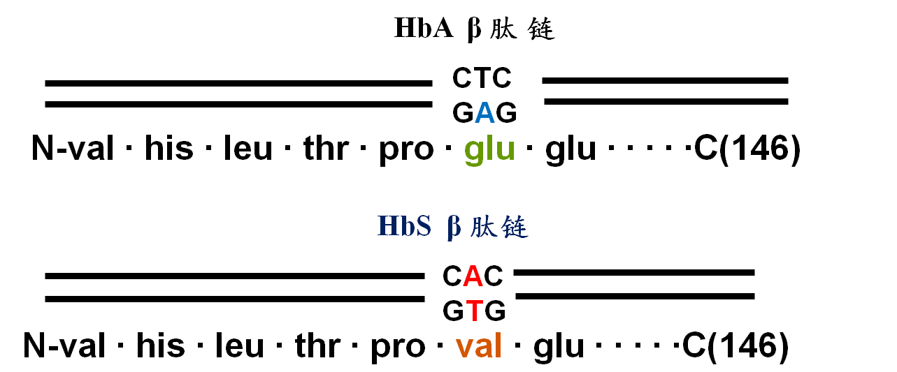
Sickle type red blood disease

Slide 8
Old paradigm--Diseases are due to single genes -by knocking out the gene, or designing specific inhibitors to its protein, disease can be cured
But the gene KO mouse didn’t notice the loss of the gene
New paradigm--We have to understand gene and protein networks - proteins don’t act alone – effective systems have built in redundancy
Notes:
Protein interactions lie at the heart of most biological processes

Slide 9
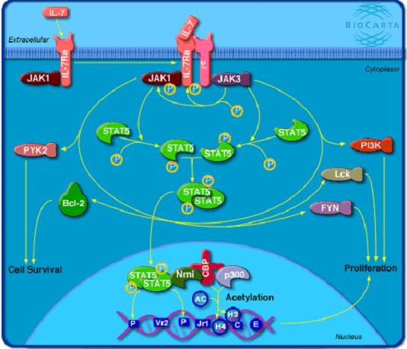
Protein-protein interaction (PPI)
PPI:
Each living cell is packed with proteins that continuously interact with each other to control the cell's growth, function and eventual fate.
They have effects on altering protein kinetic properties, substrate binding, catalysis, etc.
Researchers have developed a variety of chemical and biochemical techniques to understand the who, what, where, when and why of those interactions.

Slide 10
Interactions
proteins
small molecules
nucleic acids
proteins

Slide 11
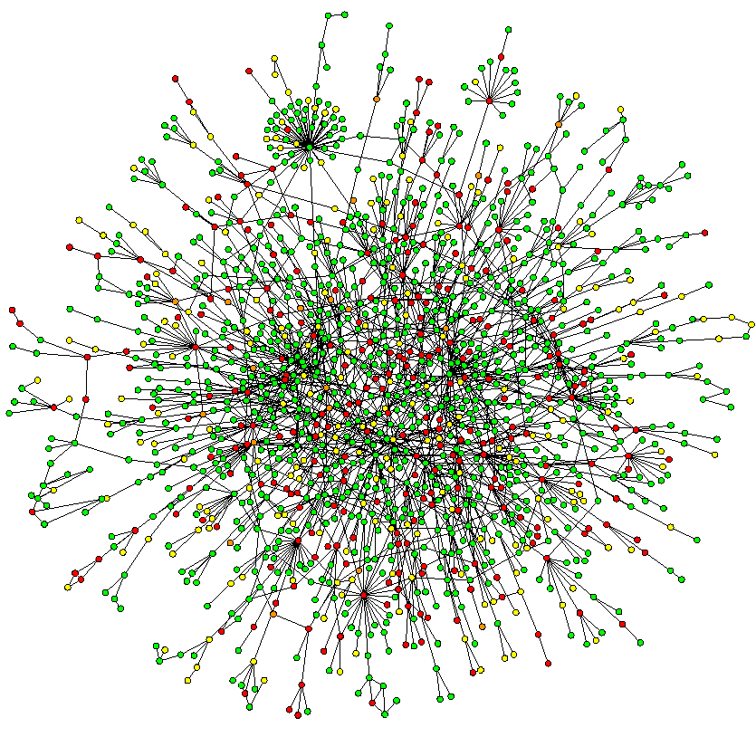
Protein-Protein Interactions
Proteins “work together” forming multi complexes to carry out the specific functions
Interactions in the yeast proteome

Slide 12
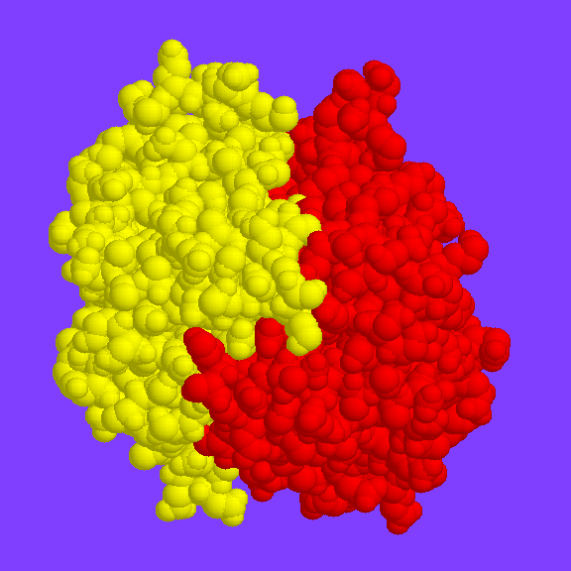
Outline
Why study protein-protein interactions？
How to study protein-protein interactions
Experimental methods
Computational prediction methods
Cases and application of protein-protein interactions study

Slide 13
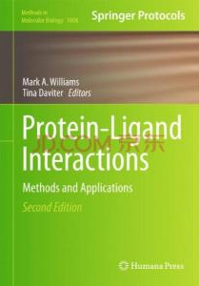
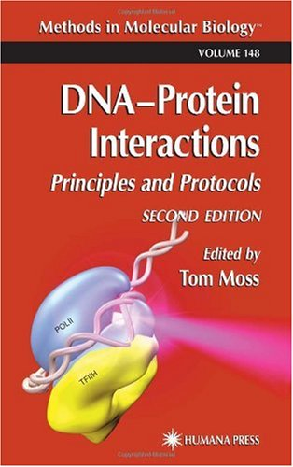
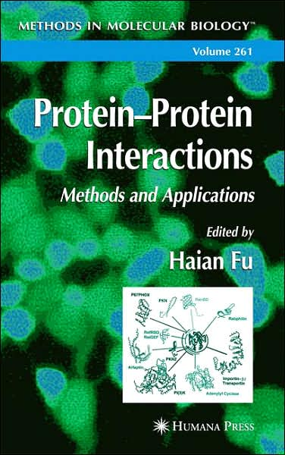
Interactions
proteins
small molecules
nucleic acids
proteins

Slide 14
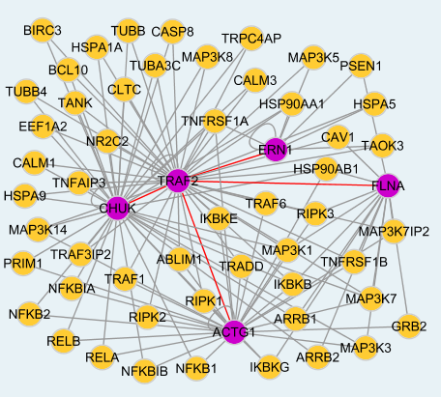
Interaction proteomics
Investigation of protein interactions at multiple levels
Atomic scale
Molecular scale (core)
binary interactions
complex interactions
Cellular scale
determining where proteins are localized

Slide 15
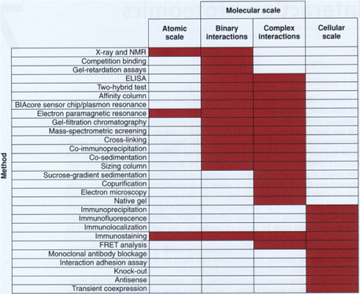

Slide 16
Identification of interactions
Experimental identification
x-ray crystallography
NMR spectroscopy
Tandem affinity purification
Immunoprecipitation
Yeast two-hybrid
Microarrays
etc
Computational predication
sequence data
protein structural information
evolutionary information
etc

Slide 17
Identification of interactions
Traditional Methods
Affinity-based biochemical methods
ELISA
Affinity purification
immunoprecipation
Physical methods
X-ray crystallography
nuclear magnetic resonance spectroscopy
fluorescence resonance energy transfer (FRET)
Genetic methods
Genomic methods
Modern Methods
Hybrid system
Y2H and its derivates
Phage display
Affinity-based biochemical methods
co-IP
GST-pull down et al
Systematic affinity
purification+MS
Protein chips
Coexpression and co-location

Slide 18
Hybrid system (in vivo PIP)
Yeast hybrid system
Yeast two hybrid system
Yeast one hybrid system
Yeast three hybrid system
Yeast reverse hybrid system
Yeast extra-nuclear hybrid system
Mamamimal hybrid system
Bacterial hybrid system

Slide 19
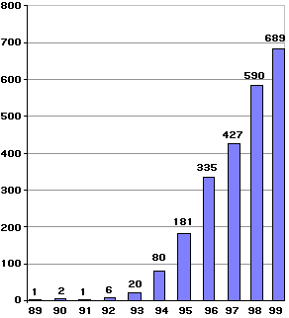
Yeast hybrid system --Detecting protein-protein/ protein-DNA interactions in yeast by the activation of downstream reporter gene(s) by the binding of a transcription factor onto an upstream activating sequence (UAS)
Yeast two hybrid system, also known as Two-hybrid screening or Y2H, a molecular biology technique used to discover protein-protein interactions and protein-DNA interactions by testing for physical interactions (such as binding) between two proteins or a single protein and a DNA molecule, respectively
Use of the yeast two-hybrid system

Slide 20
Yeast two hybrid system
Also called interaction trap
Founded by Song & Field (Nature 1989,340:245-246）
Regulation of gene expression in yeast
gene for transcription activator
Transcription activator
activation domain
DNA binding domain
Transcription machinery
UAS
(upstream activation sequence)
gene

Slide 21
Yeast two hybrid system
Basic premise —Structural character of eukaryote transcription activators
Transcription activators are modular and can function in close proximity to each other without direct binding
DNA Binding Domain (BD)
Transcriptional Activation Domain (AD)
BD
AD
transcription

Slide 22
Yeast two hybrid system—principle
‘Fishing’
--- ‘bait’ expressed as fusion protein with BD
--- ‘prey’ expressed as fusion protein with AD
bait
BD
prey
AD
library
prey
AD
prey
AD
Reporter mRNA
Reporter mRNA
prey
AD
Reporter mRNA
bait
Reporter mRNA
BD
Reporter mRNA
Reporter Gene
An interaction between the bait and a prey will bring BD and AD close together which in turn results in the transcription of a reporter gene.

Slide 25
Notes:
Now I want to explain how you can go fishing with the Yeast two-hybrid system
In fishing our question is: does protein X bind with another protein?…in other words an unknown protein Y.
In this application of the Yeast two-hybrid system we use X as the so called bait, and we try to pull in Y which can be considered the predator (I.e. the fish).
Let’s first of all consider how we prepare the bait…to help us out I’ve put the principle of the yeast two-hybrid system in the lower right.

Slide 26
Notes:
The bait is going to be constructed with protein X so we take DNA coding for X and build it into a Yeast plasmid expression system along with DNA coding for the DNA binding domain of our transcription activator.
We then use this construct to transfect yeast. By proper selection we end up with a beaker full of yeast, all expressing our hybrid protein of X attached to the DNA binding domain.
So we have half of the two hybrid system constructed.

Slide 27
Notes:
The bait is going to be constructed with protein X so we take DNA coding for X and build it into a Yeast plasmid expression system along with DNA coding for the DNA binding domain of our transcription activator.
We then use this construct to transfect yeast. By proper selection we end up with a beaker full of yeast, all expressing our hybrid protein of X attached to the DNA binding domain.
So we have half of the two hybrid system constructed.

Slide 28
Notes:
The bait is going to be constructed with protein X so we take DNA coding for X and build it into a Yeast plasmid expression system along with DNA coding for the DNA binding domain of our transcription activator.
We then use this construct to transfect yeast. By proper selection we end up with a beaker full of yeast, all expressing our hybrid protein of X attached to the DNA binding domain.
So we have half of the two hybrid system constructed.

Slide 29
Notes:
The bait is going to be constructed with protein X so we take DNA coding for X and build it into a Yeast plasmid expression system along with DNA coding for the DNA binding domain of our transcription activator.
We then use this construct to transfect yeast. By proper selection we end up with a beaker full of yeast, all expressing our hybrid protein of X attached to the DNA binding domain.
So we have half of the two hybrid system constructed.

Slide 30
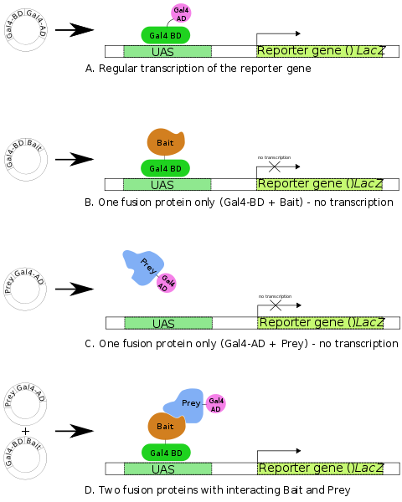
Transcription factor, Gal4p, has DNA binding (BD)(aa1-147) and transcriptional activator(AD)(aa768-881) domains
Stimulates transcription at a promoter reconized by Gal4p (upstream activating sequence, UAS)
Lac Z reporter gene encodes beta-galactosidase which produces blue pigment when the colony is grown in a media containing X-Gal

Slide 31
Three essential elements
BD fusioned protein1 expression vector (Bait)
AD fusioned protein2 expression vector (prey)
Reporter gene: usually HIS3, URA3, LacZ and ADE2
Notes:
ADE2 - phosphoribosylaminoimidazole carboxylase ADE2 磷酸核糖氨基咪唑羧化酶; URA3 - orotidine-5'-phosphate decarboxylase 乳清酸核苷-5′-磷酸脱羧酶
HIS3 - imidazoleglycerol-phosphate dehydratase HIS3 咪唑甘油磷酸脱水酶

Slide 32
Advantages
Yeast as the host—well understand, growing fast, easy for operating
In vivo technique, good approximation of processes which occur in higher eukaryotes.
Identify interaction of proteins normally expressed at low levels, weak protein interaction and transient interactions through cascade amplification to over-expression and stabilisation of interaction
Can be used to detect potential interactions of genes not yet observed to be translated into proteins (e.g. rarely expressed) or novel constructs (e.g. therapeutics)
Relatively fast and efficient.

Slide 33
Limitations
Method based on transcription
-- target should not have transcriptional activity itself
Some proteins can be toxic when bound to DNA binding domain
False positives and false negatives
Protein-protein interaction has to take place in nucleus
-- not suitable for all proteins, especially membrane bound molecules

Slide 34
Problems and corresponding countermeasures
Intranuclear action
It is not suitable for extracellular receptor ligands and extracellular processing modification, and is also not suitable for membrane proteins.
Improvement
Change the location sequence of some cell membrane
Adding the sequence of nuclear positioning signals to the carrier
A system that specializes in the role of proteins in non nuclear proteins (such as SOS recovery system and ubiquitin specific protease system).

Slide 35



Problems and corresponding countermeasures
False positive
Reason
The target protein itself contains a transcriptional activator, that is, preyAD itself activates reporter gene transcription.
The bait protein itself has activation effect, that is, BaitBD itself can activate the transcription of reporter gene.
PreyAD is not specific to baitBD
The unknown regulatory pathway activates the reporter gene,
The reasons for hybrid design are exposure area exposure, time and space damage.
Some proteins are members of proteolytic pathway based on ubiquitin protein, and have universal protein interaction ability.
Improvement
Controlled experiment
Two hybrid system based on RNA polymerase III transcription
Yeast strain PJ69-4A containing three different reporter genes (ADE2, HIS3 and LacZ).

Slide 36
Problems and corresponding countermeasures
False Negative
Fusion protein is toxic to cells
Selecting a low sensitive strain or a low copy number carrier
LexA yeast two hybrid system: the BD section of GAL4 is replaced by the lexA protein coding region of the prokaryotes. The 88 VP coding regions of herpes simplex virus have replaced the AD section of GAL4.
A CO transformation method
Weak interaction between proteins
Select a highly sensitive strain
Select a high copy carrier

Slide 37

Problems and corresponding countermeasures
The conversion rate is low (4 orders of magnitude lower than that of bacteria)
co-transformation
Yeast mating: transfer bait protein carrier and target protein vector into different conjugated haploid yeast.

Slide 38
Example: interaction of proteins with the c-terminus of the sorLA receptor
sorLA is a single transmembrane (cargo) receptor
200 aa
extracellular
intracellular
Vps10p
YWTD
LA
FnIII
N
C
sorLA-cd
sortilin
CI-MPR
40 50
-29aa--DDLGEDDEDAPMITGFSDDVPMVIA
-29aa--DALDTASHTNKSGYHDDSDEDLLE
-139aa-----------LVSFHDDSDEDLLHI
*
How to design YTH (yeast two hybrid)?

Slide 39
Interactors with the intracellular tail of SorLA
Vps10p
YWTD
LA
FnIII
N
C
A YTH screen revealed the interaction with GGA2

Slide 40
Question?
Y2H can be used to detect interactions between two proteins. Can it be used to detect binding sites between them?
If possible, how should you design the experiment?
Mutagenesis

Slide 41


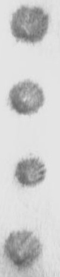


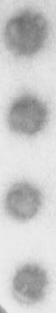

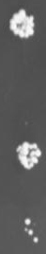
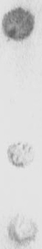

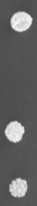
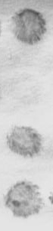
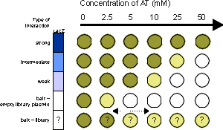
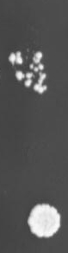







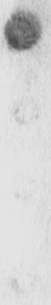



Analysis of the interaction of sorLA and GGAs by direct YTH and Alanine scanning
GAL4bd-sorLA cds
GAL4ad-
GGA1
GAL4ad-
GGA2
β-Gal
β-Gal
-His
-Ade
-His
-Ade
Mutant SorLA
GGA2
40aa-DEDAPAATGFSDDVPMVIA
40aa-DEDAPMITGASDDVPMVIA
40aa-DEDAPMITGFADDVPMVIA
40aa-DEDAPMITGFSDDAPMVIA
40aa-DEPAPMITGFSDDVAMVIA
40aa-DEDAPMITGFSDDVPAVIA
40aa-DEDAPMITGFSDDVPMAIA
40aa-DEDAPMITGFSDDVPMVAA
40aa-DEDAPMITGFSAAVPMVIA
40aa-DEDAPMITGFSADVPMVIA
40aa-DEDAPMITGFSDAVPMVIA
40aa-DEDAPMITGFSDDVPMVIA
40aa-DEDAPMITGFSDDVPMVIG
40aa-DEDAPMITGFSDDVPMGIA
40aa-DEDAPMITGFSDDVPMVGA
40aa-DEDAPMITGFSDDVPMPIA
screened for strength
Notes:
In molecular biology, alanine scanning is a technique used to determine the contribution of a specific residue to the stability or function of given protein.

Slide 42
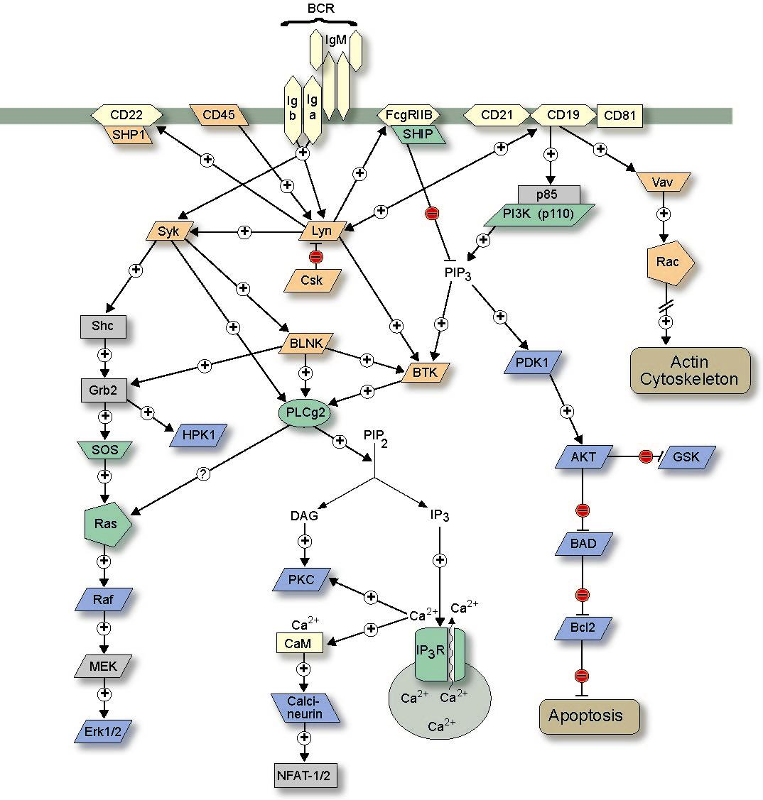
B Cell Receptor Pathway

Slide 43
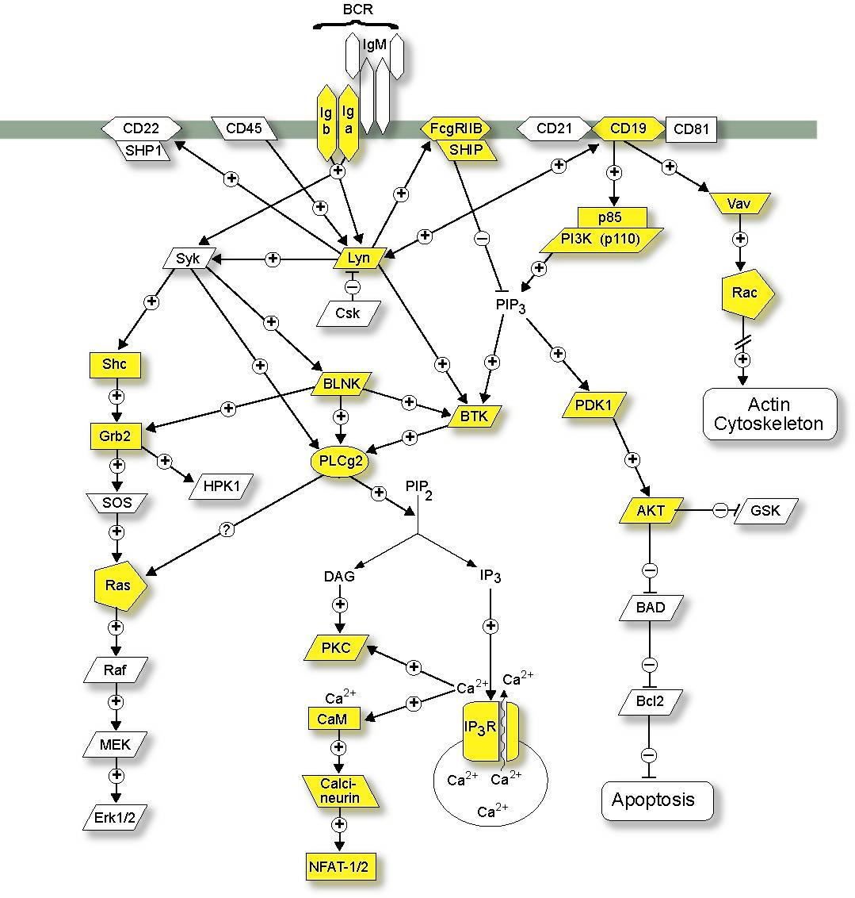
B Cell Receptor Pathway

Slide 44
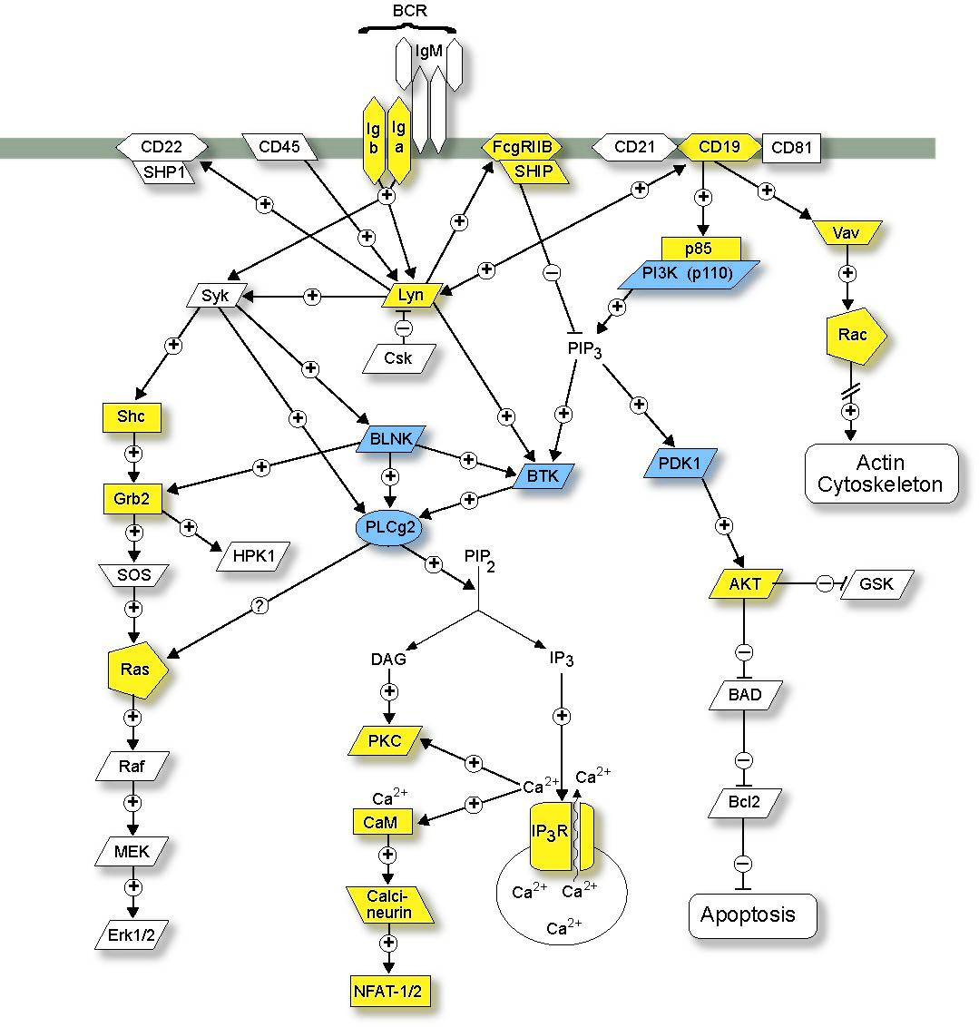
B Cell Receptor Pathway
Nck
14-3-3z
Endophilin2
BAN-P
Pak
PDE4B3
-
Pix/Cool
Ruk1
Git2
PP2C
gamma
Notes:
And then the blue highlights here show proteins for which we have interaction data..
I’m not going to describe these ints in the detail that I did last year, but we saw a nice pattern where the assay was confirming several established ints, such as the PI3Ks and several of the ints over on the right involving the actin cytoskeleton..
But also providing novel data such as PLC gamma 2 binding SHIP and also this adapter protein Ruk1 which has been proposed to regulate PI3K activity..

Slide 45
Yeast one hybrid system
Founded by Wang & Rddd in 1993
Study the Protein-DNA interactions
Replace bait-BD hybrid protein with protein-binding DNA
‘bait’ DNA binding site or novel promoter
‘prey’ expressed as fusion protein with AD
prey
AD
transcription
Reporter gene

Slide 46
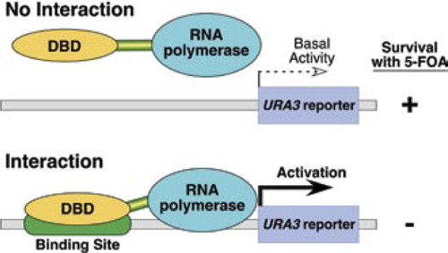

Slide 47
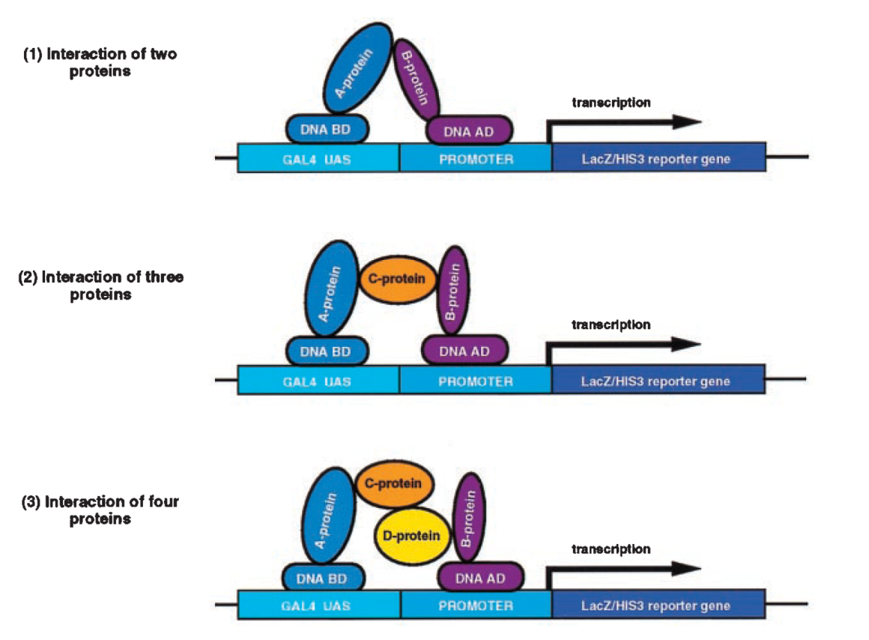
Yeast three hybrid system
Founded by SenGupta
Main characters：there are no direct interaction between X and Y, their interaction is mediated by the exist of the third molecule A
Aim：study the interaction among two proteins and a third molecule which could be protein, RNA or small molecule

Slide 48
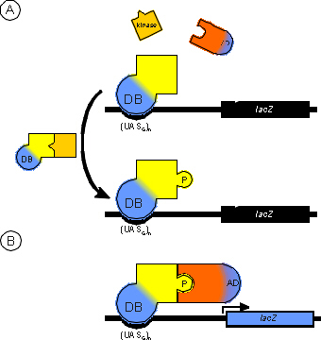
Yeast three hybrid system
- interaction is dependent on phosphorylation of bait: co-expression of tyrosine kinase Lck
PY
transcription

Slide 49
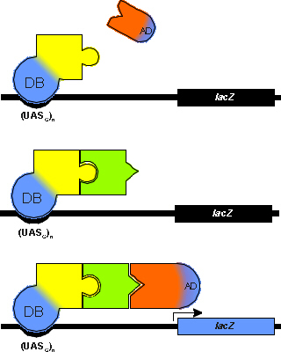
- interaction is dependent on presence of third protein
transcription

Slide 50
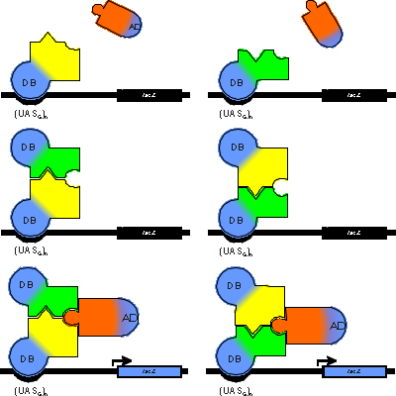
- interaction is inhibited by presence of third protein
no transcription
Tirode et al
A conditionally expressed third partner stabilizes or prevents the formation of a transcriptional activator in a three-hybrid system. J.Biol.Chem. 1997,272: 22995-22999.
Based on the addition of a Met25 promoter for the third partner.
Transcription of the third protein is repressed upon addition of methionine in the culture medium

Slide 51
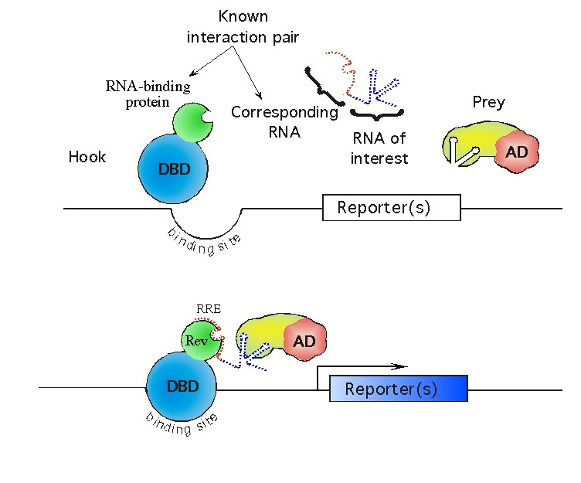
-interaction is dependent on presence of RNA

Slide 52
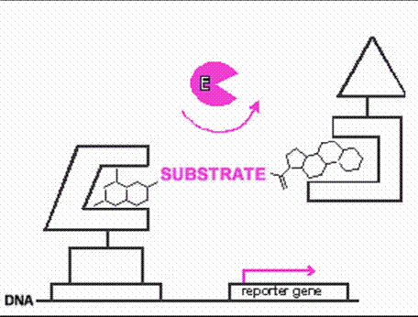
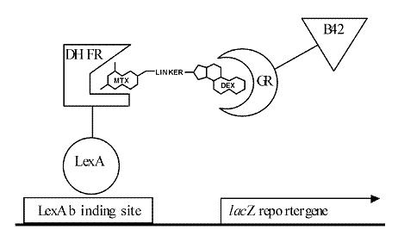
-interaction is dependent on presence of Small ligand

Slide 53
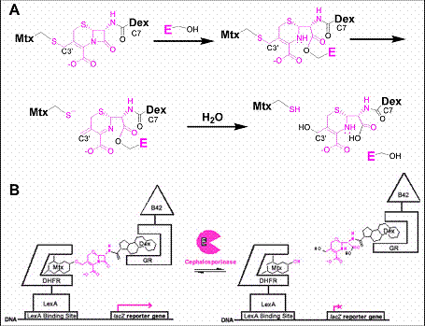
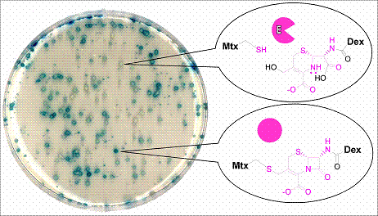
Virginia W. Cornish. CHEMICAL COMPLEMENTATION:A REACTION-INDEPENDENT GENETIC ASSAY FOR IRECTED EVOLUTION
http://www.beilstein-institut.de/bozen2004/proceedings/Cornish/Cornish.htm

Slide 54



Reverse two-hybrid system
The two-hybrid system does not allow genetic selection of events responsible for dissociation of particular interactions
Founded by Shih et al in 1996
Study the mechanism of dissociation of particular interactions
Character: use yeast strains in which expression of interacting hybrid proteins increases the expression of a counterselectable marker that is toxic under particular conditions
Notes:
研究阻断大分子间特定相互作用的机理
特点：利用反向筛选报告基因，即蛋白间特异相互作用所激活的报告基因能阻碍宿主菌的生长，从而发现蛋白间结合的解离因素。
All reverse systems make use of yeast strains in which expression of interacting hybrid proteins increases the expression of a counterselectable marker that is toxic under particular conditions. Under these conditions, dissociation of an interaction provides a selective advantage, thereby facilitating detection: a few growing yeast colonies in which hybrids fail to interact can be identified among millions of non-growing colonies expressing interacting proteins.
The first reverse two-hybrid system uses a yeast strain that is resistant to cycloheximide due to the presence of a mutant CYH2 gene. This strain also contains the wild-type CYH2 allele under the transcriptional control of the GAL1 promoter. Expression of the wild-type GAL4 protein is sufficient to restore growth sensitivity to cycloheximide. Growth sensitivity towards cycloheximide is also restored by the co-expression of the avian c-Rel protein and its Ik B-a counterpart, p40, as GAL4 fusion proteins. Restoration of growth sensitivity towards cycloheximide requires the association of c-Rel and p40 at the GAL1 promoter and correlates with the ability of the c-Rel/p40 interaction to activate expression from the GAL1 promoter
Another reverse hybrid system makes use of the most widely used counter-selectable marker in yeast genetics, URA3, which encodes orotidine-5’-phosphate decarboxylase, an enzyme required for the biosynthesis of uracil. Yeast cells that contain wild-type URA3, either on a plasmid or integrated in the genome, grow on media lacking uracil (URA3+ phenotype). However, the URA3-encoded decarboxylase can also catalyze the conversion of a non-toxic analogue, 5-fluoroorotic acid (FOA) into a toxic product, 5-fuorouracil

Slide 55
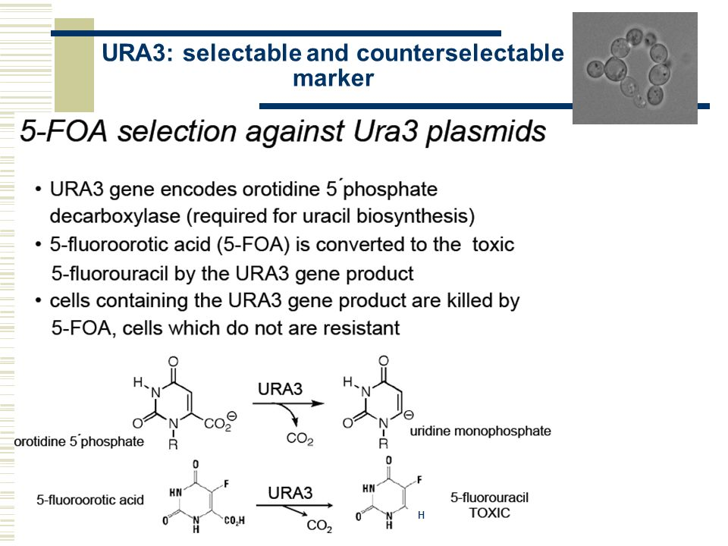





URA3: Selectable and counterselectable marker
URA3 gene encodes orotidine-5'-phosphate decarboxylase (required for uracil biosynthesis)
5-fluoroorotic acid (5-FOA) is converted to the toxic 5-fluorouracil by the URA3 gene product
Cells containing the URA3 gene product are killed by 5-FOA, cells which do not are resistant

Slide 56
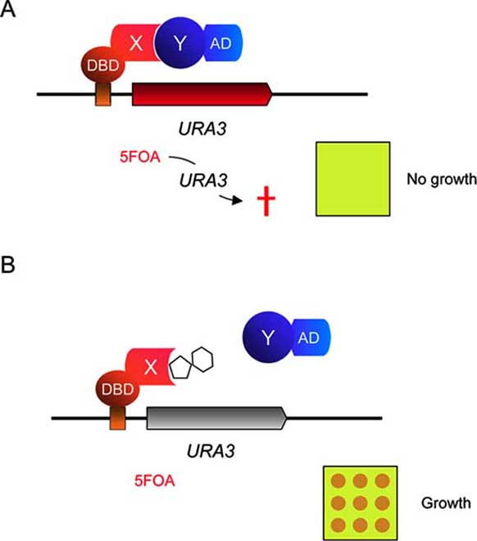

Slide 57
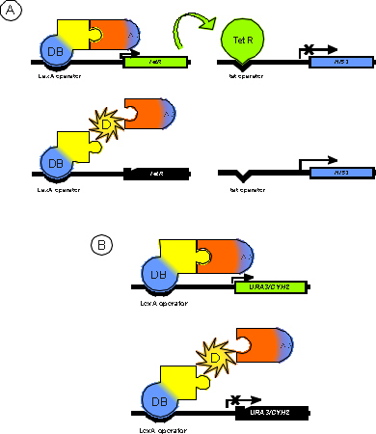

Slide 58
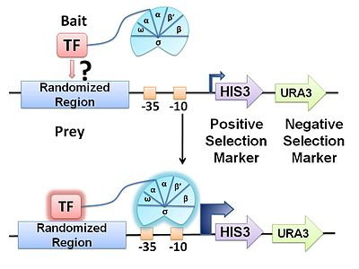

Two-reporter system
Notes:
例URA3: 编码的酶使细胞不能在5-氟乳清酸存在下生长，即表现酵母菌对5-氟乳清酸敏感．相反，如果融合蛋白质的相互作用被阻断，URA3则不表达，酵母菌则表现对5-氟乳清酸的抗性

Slide 59
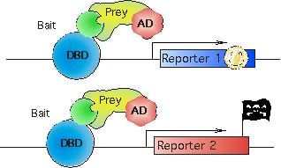
Two-reporter system
Reporter 1 (HIS3) is used for positive selection
Interaction between DBD- and AD-fused proteins results in growth on medium lacking histidine
Reporter 2 (URA3) is used for counterselection.
Interaction between DBD- and AD-fused proteins results in lethality on medium containing 5-fluoroorotic acid (5FOA), a toxic metabolite of the URA pathway.
URA3, encoding orotidine-5’-phosphate decarboxylase, an enzyme required for the biosynthesis of uracil.
Yeast cells that contain wild-type URA3 grow on media lacking uracil (URA3+ phenotype).
the URA3-encoded decarboxylase can also catalyze the conversion of a non-toxic analogue, 5-fluoroorotic acid (FOA) into a toxic product, 5-fuorouracil
Notes:
例URA3: 编码的酶使细胞不能在5-氟乳清酸存在下生长，即表现酵母菌对5-氟乳清酸敏感．相反，如果融合蛋白质的相互作用被阻断，URA3则不表达，酵母菌则表现对5-氟乳清酸的抗性

Slide 60
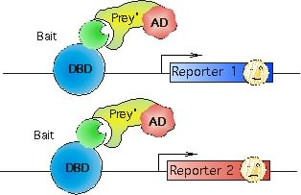
Mutagenesis of DBD- or AD- fusion protein, mutations which weaken the interaction
-- display slow growth on both media
Mutations or truncations which completely abrogate the interaction
-- moderate to strong growth on 5FOA medium,
-- no growth on histidine- medium.

Slide 61
Dual Bait System
Facilitates the simultaneous comparison of two distinct baits with one prey
In a single yeast cell, two different DB sources and a common AD prey are introduced simultaneously.
The interaction between "bait" and "prey" activate the expression of "bait" specific report gene.
The screening efficiency and sensitivity are improved.
Target gene mutation sites can be studied to compare the specificity of interaction between target proteins and different members of the same protein family.

Slide 62
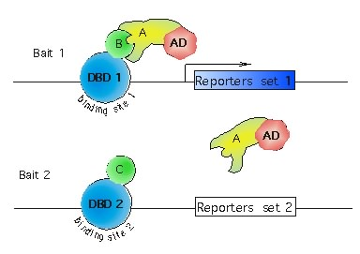
Dual Bait design
Single prey with two different baits
--Select preys that interact with the DBD1-B but not DBD2-C from a library.
--If starting with a prey that interacts with both DBD1-B and DBD2-C, it can be used to select for mutations or molecules that selectively disrupt the interaction with one of the two baits.
Curr. Protoc. Mol. Biol. 86:20.7.1‐20.7.32. © 2009

Slide 63
Non-nuclear Y2H: --Sos recuiment system, SRS
Described by Aronheim (Mol.Cell.Biol. 1997,17: 3094-3102)
Based on the observation that the mammalian GDP-GTP exchange factor (GEF) hSos can only activate Ras when hSos is localized to the plasma membrane
In mammalian cells, this occurs by recruitment to the cytoplasmatic tail of activated growth factor receptors.
A yeast strain containing a point mutation in the yeast Ras GEF cdc25-2, shows temperature-sensitive growth
Notes:
Expression of a cytoplasmic mammalian activated Ras (devoid of its CAAX box;
mRas(61)) fused to protein X (the ‘bait’) in cdc25-2 cells is unable to
promote cell growth at the restrictive temperature (36°C). The yeast
Ras (yRas) is present in the GDP-inactive form due to the absence of a
functional exchange factor Cdc25 at the restrictive temperature.
(b) Upon interaction between the bait protein and a membranelocalized
protein partner, Ras will be localized to the plasma membrane
and will be able to confer cell growth at the restrictive temperature.
The protein partner for the bait could be a known protein partner, a
putative protein partner (‘prey’), or a protein encoded by a cDNA in a library screen — as shown here

Slide 64

Normally, A yeast strain containing a point mutated cdc25-2 grows at 25 ℃, but not 36 ℃,
Expression of hSos artificially targeted to the membrane by myristoylation (豆蔻酰化 ) or farnesylation (法尼基化 ) can restore growth at the non-permissive temperature.
The target protein (X), is fused to hSos, and the partner protein (Y) or cDNA to be screened is fused to a membrane-localization signal→ co-expressed in a cdc25-2 yeast strain→having interation, the cells can grow at the nonpermissive temperature

Slide 65
Strain：cdc25-2 MATa (ura3 lys2 leu2 trp1 cdc25-2 his3-D200 ade101 GAL+)
Temperature sensitive yeast strain; grow on YPD plates at 24°C.
vector ：
pMS-TRP (TRP1)--This expression vector has the myristoylation signal under GAL control and is used for library
pSOC4 (URA3)-- SOS expression vector with polylinker at C terminus for fusions
pSON8 (URA3)--SOS expression vector with polylinker at N terminus for fusions
Screen
temperature-resistant colonies
5-FOA selection
select for the loss of the bait plasmid to test for plasmid dependency of the growth phenotype.
Loss of the URA3 plasmid will also facilitate recovery of the library plasmid from yeast.

Slide 66
ubiquitin-based split-protein sensor system (USPS system)
Designed by Staglart et al
Based on the fact that newly formed fusions between ubiquitin(a 76-residue single-domain protein) and proteins are rapidly cleaved by ubiquitin-specific proteases which recognize the folded conformation of ubiquitin in cytosol in eukaryotes.
Notes:
, 分离的泛素系统
泛素是一种在真核细胞中普遍存在的由76个氨基酸组成的蛋白质，结构保守。其生理功能是结合在蛋白的N端作为泛素特异蛋白酶(ubiquitin．specific protease，UBP)剪切蛋白质的标记。
在胞质中发挥作用

Slide 67

USPS system
Reporter
Suitable for interaction in cytoplasmic and membrane bound proteins

Slide 68
Y
X
Y
X
CUb
NUb
CUb
NUb
Ubiquitin specific protease

R
R
If X and Y interact, it compels Nub to approach the Cub space, reconstructs a functional ubiquitin, and the reporter protein is cut down into the nucleus by UBP and activates the expression of a specific reporter gene.
Advantages: the contradiction between the interaction between membrane proteins and the activation of nuclear reporter genes is solved in two aspects.

Slide 69


Slide 70

cytosolic yeast two-hybrid system (cytoY2H)
Split protein biosensor assays in molecular pharmacological studies
https://doi.org/10.1016/j.drudis.2015.11.004
Yeast Two-Hybrid, a Powerful Tool for Systems Biology
Int J Mol Sci. 2009 Jun; 10(6): 2763–2788.

Slide 71


Slide 72
Mammalian Two-hybrid system
Designed by Rossi F and Charlton C A in 1997 (Proc Natl Acad U S A 1997,94:8405-8410）
Also utilizing the separability of eukaryotic transcription activating factors
One fusion with the GAL4 DNA-BD
One fusion with VP16 AD
A third vector, pG5CAT, contains the CAT reporter gene downstream of a GAL4 responsive UAS
Make up the inability of yeast cells to do some kind of protein modification

Slide 73
Mamalian two-hybrid assay
Is analogous to Y2H assay
Plasmids: 1)Gal4pBD-fusion vector
2)VP16AD-fusion vector(viral activator)
3)luciferase reporter plasmid contaning
multiple copies of Gal4p binding sites(UAS)
Co-transfection: in the case of interaction, luciferase activity will be detected
Advantage: good for studying mammalian proteins: they may not fold correctly in yeast or they may require post-tranlational modifications for protein interaction

Slide 74

Transcription activator: VP16–Gal4 transactivator complex
the BD of GAL4
the AD of VP16 单纯疱疹病毒
Reporter gene
Luciferase, chloramphenicol acetyltransferase(CAT), cell surface marker CD4 and Hygromycin resistance
Mammalian cell hosts
Chinese hamster ovary cell (CHO), African green monkey kidney (COS) and other cells

Slide 75


Slide 76

CheckMateTM Mamalian two-hybrid system
pBIND---containing the yeast GAL4 DNA binding domain
pACT---containing the herpes (疱疹）simplex virus VP16 activation domain
pG5-luc---containing five GAL4-binding sites upstream of a minimal TATA box, followed by the firefly luciferase gene
To inducibly modulate the expression
the CMV (cytomegalovirus) promoters of pBIND and pACT were replaced with tumor necrosis factor a (TNFa) inducible nuclear factor kB (NFkB) response elements.
Sadowski， I.et al .(1998) Nature 335 ,563

Slide 77
Bacterial two-hybrid system
Principle:
The proteins to be studied are fused with DNA binding domain (DB) and activation domain (AD) separately.
By using the bridging function provided by interacting proteins, the activation domain is combined with DNA binding domain to regulate the expression of reporter genes.
Advantage:
The study period was short (E. coli < 1 day, yeast > 6 days).
Simple operation (isolation and amplification of plasmids are very simple)
It can produce larger libraries (yeast 106 cfu/ug DNA, Escherichia coli 109 cfu/ug DNA)
Lower false positive and false negative rates

Slide 78


Escherichia coli two-hybrid system
Proposed by Karimova in 1998
Based on the reaction catalyzed by CaM-dependent adenylate cyclase (cAMPase, CyaA) encoded by CyA gene in Bordetella pertussis.
Adenylate cyclase
A membrane Integrated protein
Mainly distributes in the plasma membrane, nuclear membrane and endoplasmic reticulum
Transform ATP into cAMP and induce cell signal response.

Slide 79
Escherichia coli two-hybrid system
Principle:
The catalytic domain of cAMPase for the synthesis of cAMP is divided into two relatively independent functional units, T18 and T25.
When T18 and T25 were introduced into E. coli DHP1 (cya-) strain as two independent entities, they could not recognize and interact with each other, complement the cya-deficient properties of E. coli DHP1, and exhibit low activity of beta-galactosidase, which was a white colony on MacConkey maltose plate.
If the proteins to be examined can interact with each other, the T18 and T25 fragments can be combined to form functional cAMPase and catalyze the formation of cAMP. The synthesized cAMP activates the expression of lactose or maltose operon and produce recognizable phenotypic changes.

Slide 80

Bacterial Adenylate Cyclase Two-Hybrid System

Slide 81


Slide 82
Bacterial one-hybrid system
a method for identifying the sequence-specific target site of a DNA-binding domain.
In this system, a given transcription factor (TF) is expressed as a fusion to a subunit of RNA polymerase

Slide 83
Questions
What are the methods that can be used for functional proteome study? How are they classified (three levels)? Tell the principles of different methods?
What is the principle of hybrid system? How is hybrid system classified?
What are the defects of yeast two-hybrid system? How to improve them?
Tell different types of yeast hybrid systems. What are their characteristics?
What is false positive? What is false negative? What are the causes of false positive (or false negative) yeast two-hybrid?
According to the principle of yeast hybrid system, please design an experiment to study the interaction mechanism between plant resistance genes and pathogenic bacteria non-toxic genes.

Slide 84
7 完成下面给的表格
Problem
Cause
Solution
1 BD/bait activates
reporter genes
2 Excessive background
3 Low transformation
efficiency
4 Failure to detect known protein interactions

Slide 85



What kind of hybrid system will be determined according to the graph?

Slide 86



Notes:
Protein X (dark blue puzzle piece, part of bait construct) and protein Y (light blue puzzle piece, part of prey construct) directly interact (fitting puzzle pieces), thus inducing reconstitution of split-proteins (puzzle pieces of different colors in A, D, E), membrane recruitment (B, C) or protein dimerization (F). Protein fusions in bait or prey constructs are shown as solid black lines between puzzle pieces. Bait-prey interaction activates further downstream events (arrows) that directly (A) or indirectly (B, C, D, F) lead to transcriptional activation, or are independent of transcriptional activation (D, E), finally yielding screenable readouts like growth on specific media or color reactions. (A) Nuclear Y2H systems all require protein recruitment and bait-prey interaction at nuclear DNA. The classic Y2H and RTA Y2H both engage RNA polymerase II (RNA Pol II) transcription either by its activation or its inhibition. By contrast, the Pol III Y2H, involves RNA polymerase III (RNA Pol III) transcription. (B) Ras signalling based Y2H at the plasma membrane. The SRS Y2H, RRS Y2H, and rRRS Y2H are all based on protein recruitment to the plasma membrane via bait-prey interaction and subsequent activation of MAPK downstream signalling. While in the SRS and RRS Y2H the prey constructs harboring protein Y are anchored at the membrane via myristoylation to analyze interactions with cytosolic bait constructs harboring protein X, the rRRS is used to analyze interactions between soluble preys containing protein Y and partner X being a membrane protein. (C) G-protein signalling-based Y2H at the plasma membrane. In the G-protein fusion Y2H, bait X is a membrane or membrane-associated protein whose interaction with the prey construct disrupts protein G downstream signalling. (D) Split-ubiquitin based Y2H systems involve reconstitution of ubiquitin from two domains upon bait-prey interaction. Their subcellular localization depends on the nature of interacting proteins X or Y, and on the reporter proteins used. The Split ubiquitin Y2H uses non-transcriptional reporting of protein interactions in the cytosol, but can also be used for membrane proteins (not shown). The MbY2H is used for interaction analysis with membrane baits and thus occurs at the membrane location of protein X, e.g. the plasma membrane. The CytoY2H is used for membrane anchored cytosolic baits and occurs close to the ER membrane (E) Split-protein sensor Y2H. The Split-Trp Y2H is used to assay cytosolic bait-prey interactions based on reconstitution of an enzyme in tryptophan synthesis, allowing for non-transcriptional reporting. (F) ER Y2H system. The SCINEX-P Y2H allows bait-prey interaction analysis in the reducing environment of the ER, based on protein dimerization in unfolded protein signalling. ER, endoplasmic reticulum; for further abbreviations and details see chapter 3.2.

Slide 87
Outline
Why study protein-protein interactions？
How study protein-protein interactions
Experimental methods
Computational prediction methods
Cases and application of protein-protein interactions study

